Slide 1
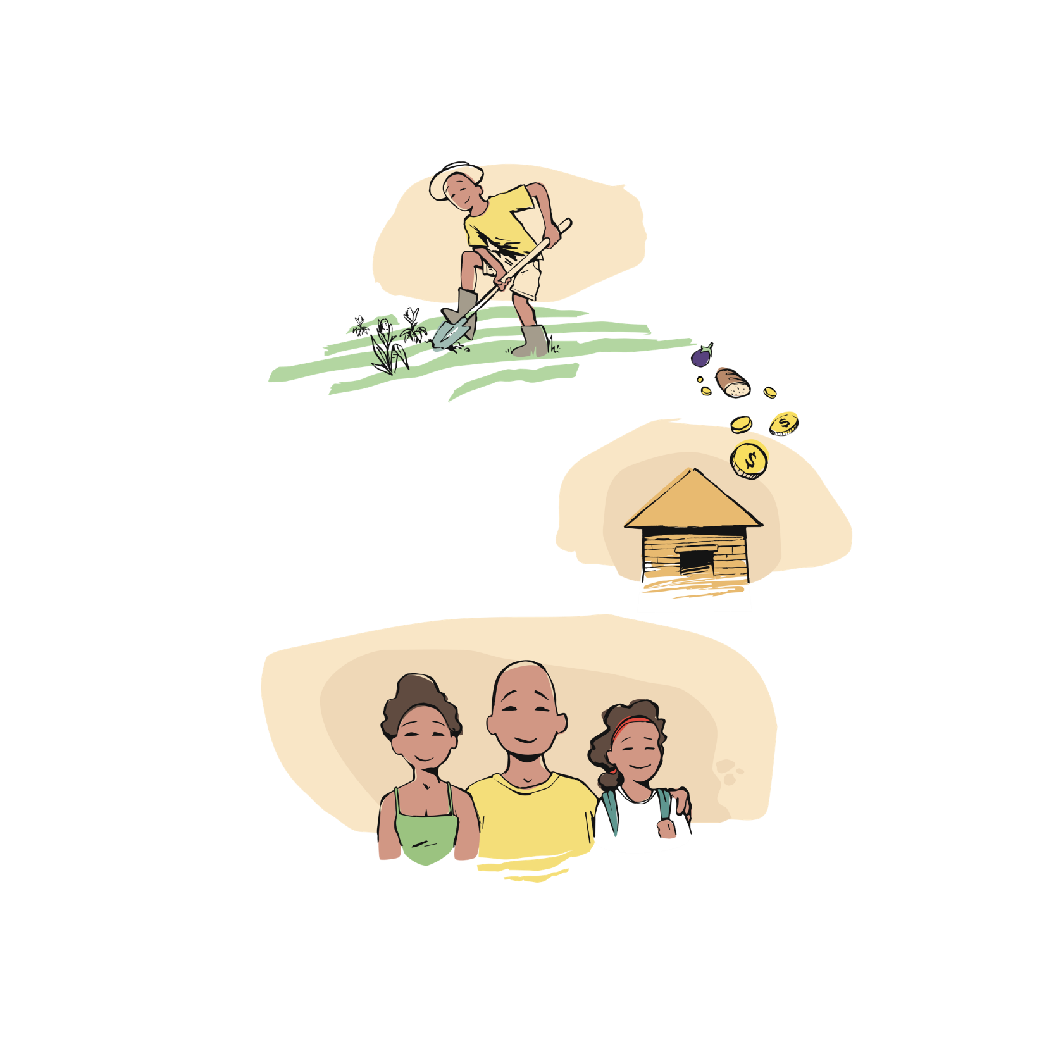
Looking at the impact in the Pacific
Take a man in the Pacific with a bright future. He works hard and is able to provide for his family and contribute to the wider community.
His life is full and enjoyable; his wife works and his daughter goes to the local school.
Economic Impact
Notes:
Notes for teacher:
The Fred Hollows storyboard for comparison

Slide 2

But then darkness sets in - over time, his sight starts to deteriorate.
Economic Impact

Slide 3

Suddenly, he can no longer work and his daughter now needs to stay home from school to look after her father, keeping her from her education.
Economic Impact

Slide 4
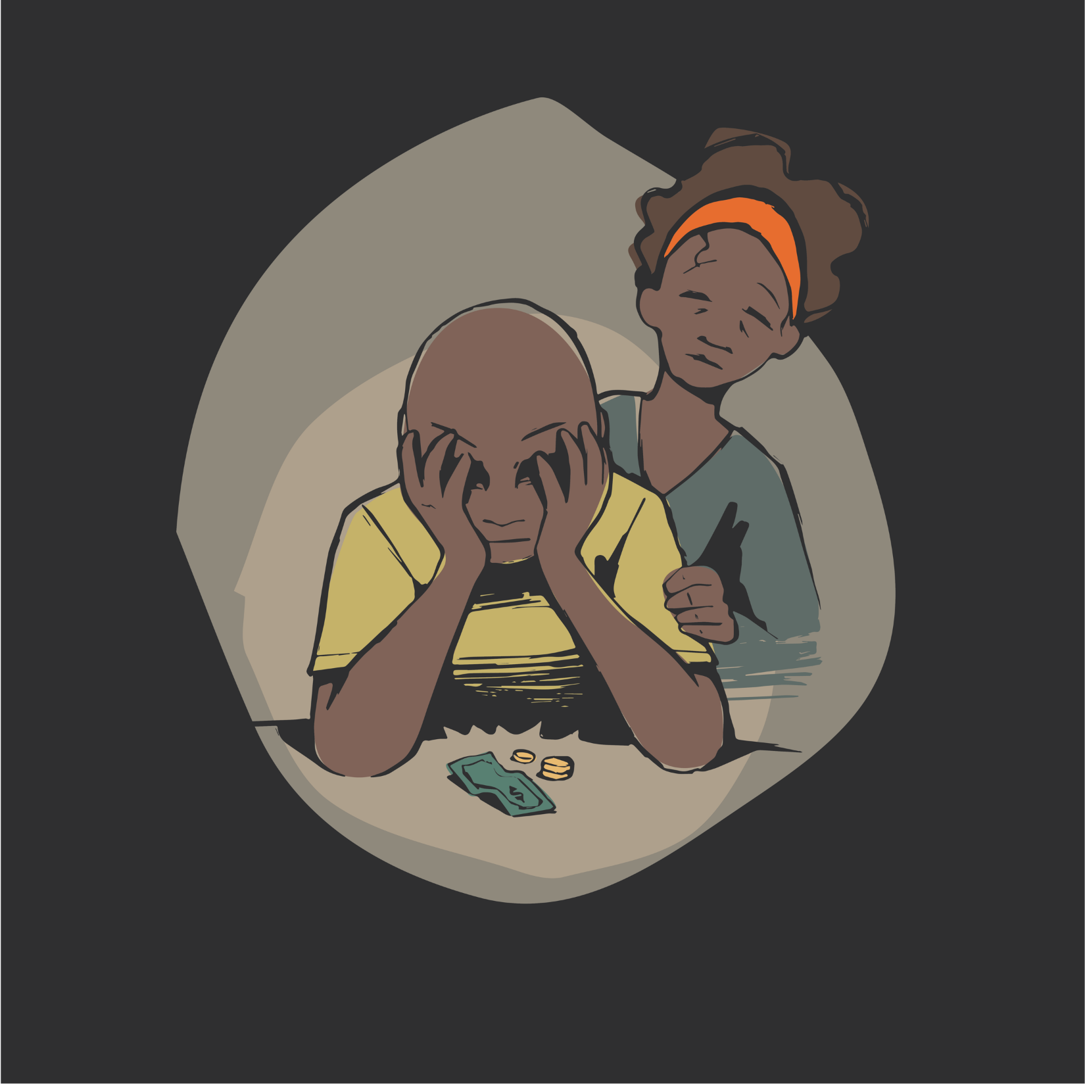
Now, his wife is the sole earner for the household.
Economic Impact

Slide 5
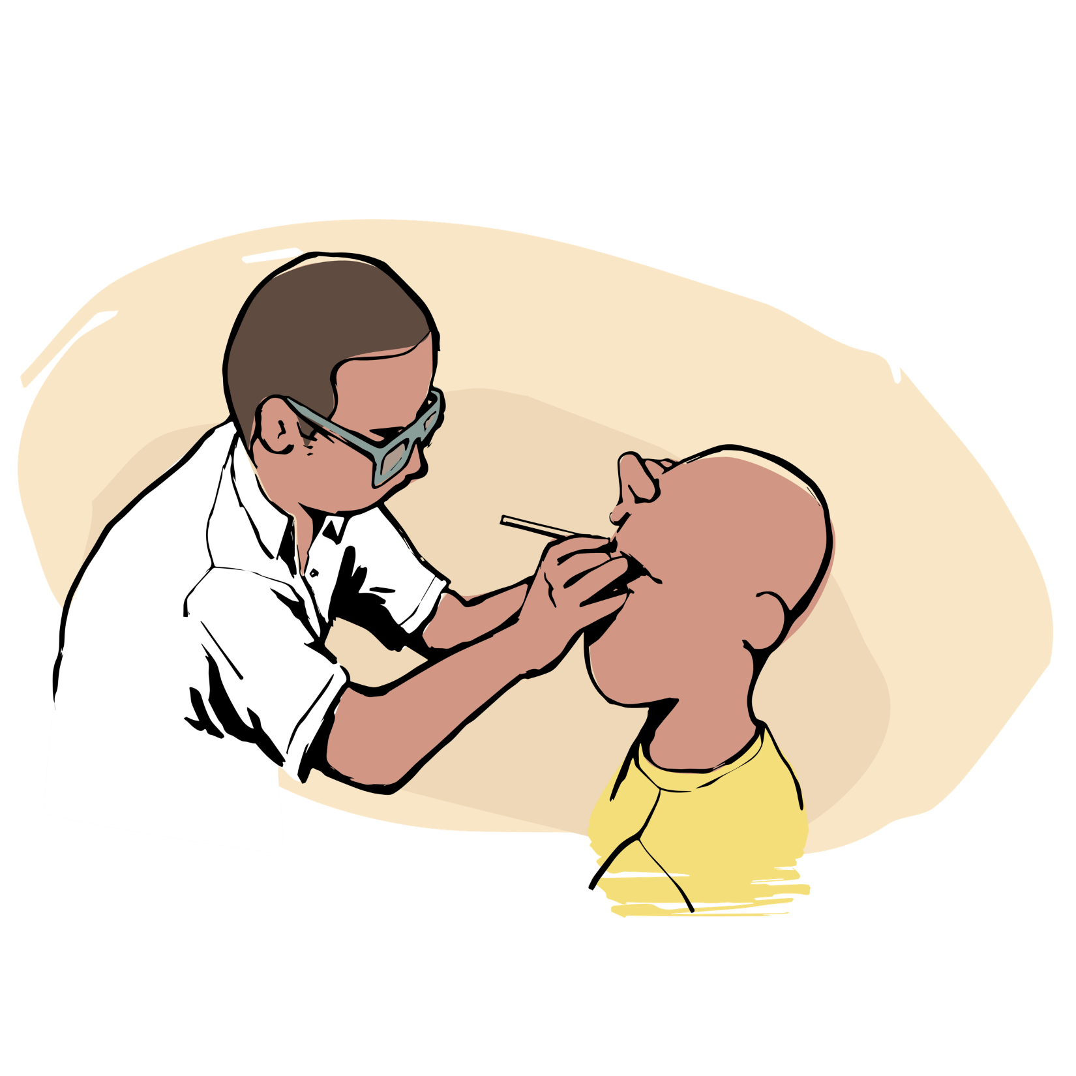
They hear that The Fred Hollows Foundation’s Pacific Outreach team are visiting his country and they are able to perform a 20-minute
sight-resorting operation.
Economic Impact

Slide 6

He is able to return the next day to have his bandages removed. He opens his eyes and light comes streaming in. He can now see the faces of his family again.
Economic Impact

Slide 7
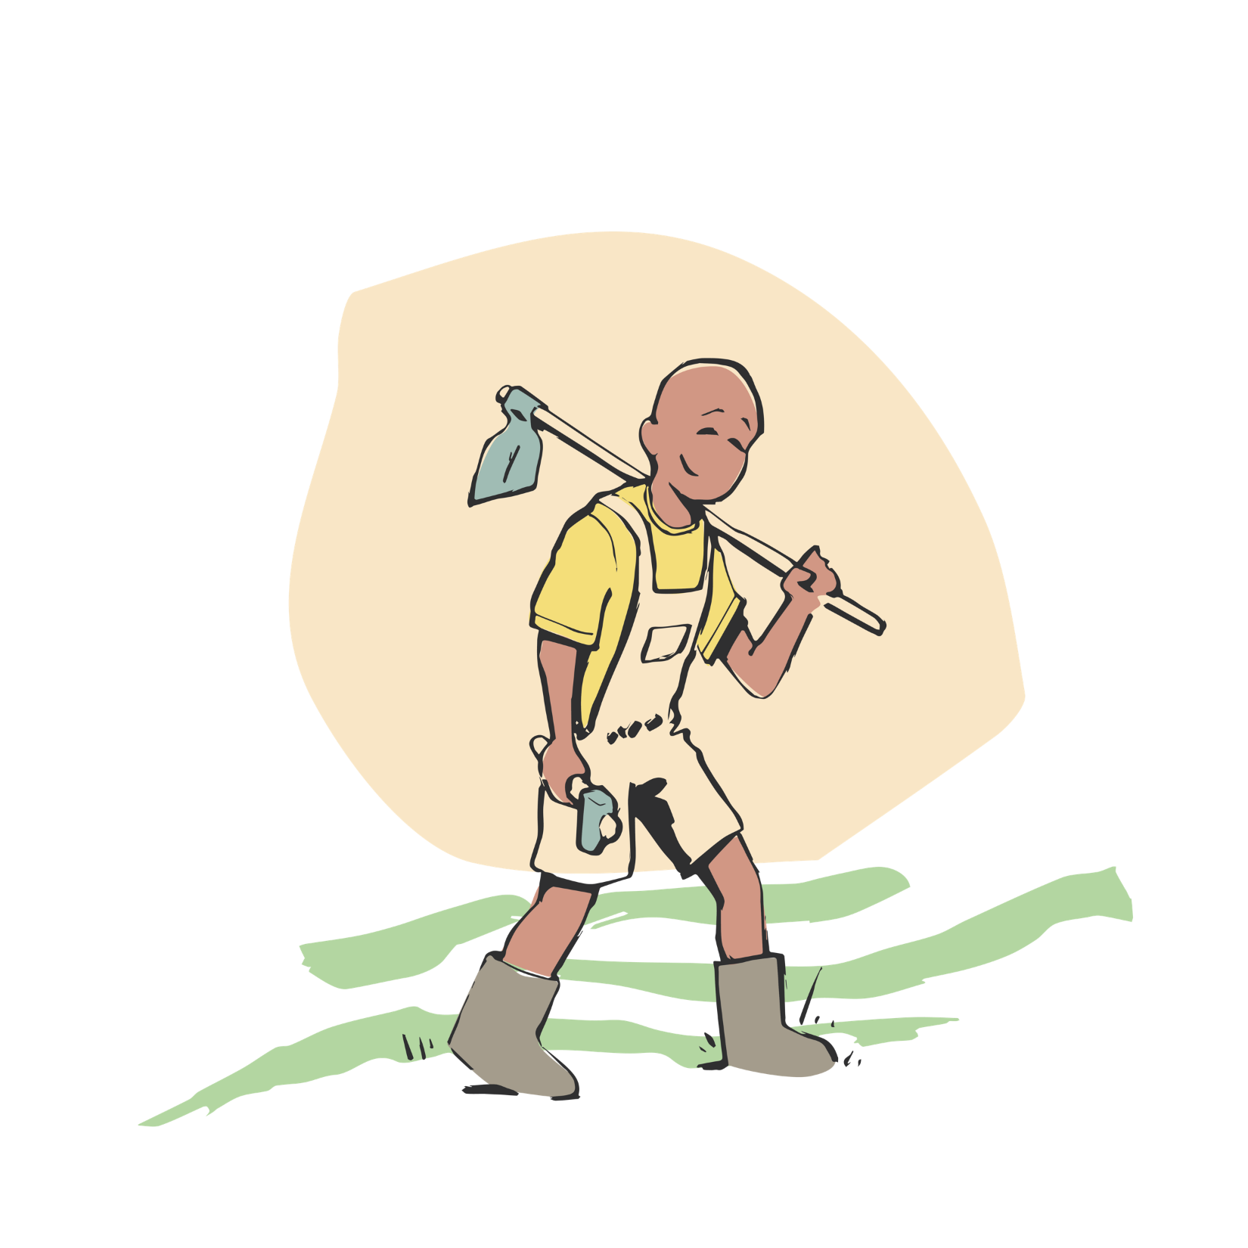
He has his life restored - he returns to work, independent and proud once more. Able to provide for his family, pay his bills and contribute to his community again.
Economic Impact

Slide 8
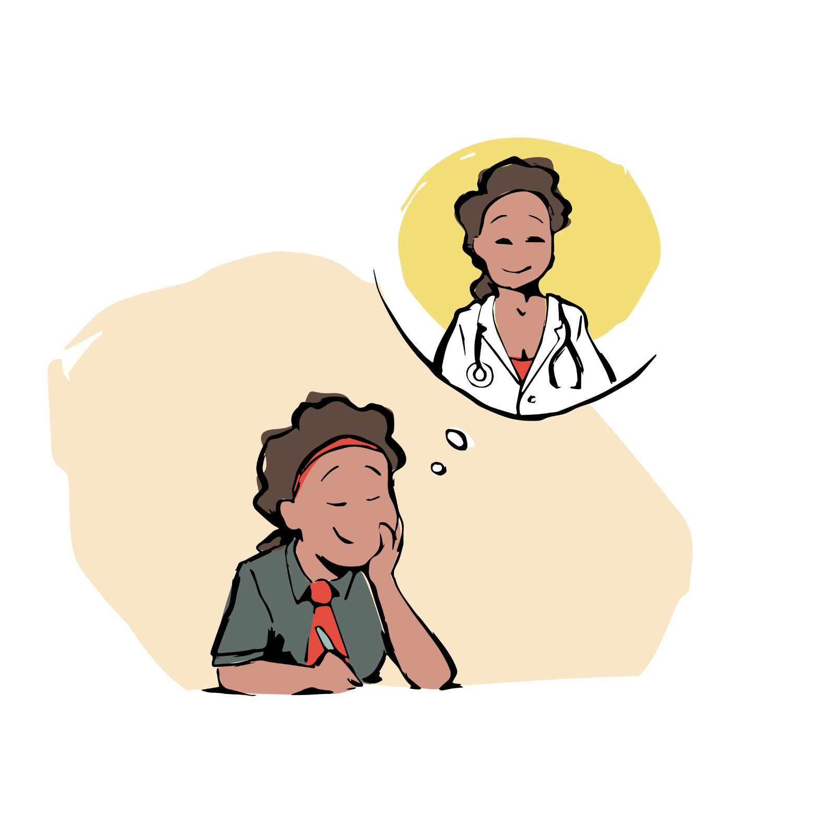
His future looks bright, and so does his daughters, who is now able to return to full-time schooling. She dreams of becoming an eye doctor to help people like her father.
Economic Impact

